Slide 1
AOJ
NAZRETH SCHOOL OF FAMILY BUILDING
NATIONAL REPORT
AUGUST 2021

Slide 2
CENTRAL REGION – UP WEST
Testimonies
  Sol. Bindu, her brother was taking drugs, but during these classes he did not take. Praise God
  Sol. Ashok Das: Even though he was serving the lord from so many years, but my family life was shattered, and empty inside but during class he received the repentance and God filled his heart and anointed him. All glory to God
  Sol. Rajeshwari: My family was broken and shattered but through this meeting my family is rebuild. Praise God.
Training Coordinator Name: Sol. Jannet Lawrence
Date:28/6/2021 to 1/7/2021
Time: 4.00 to 7:30 P . M
State: Uttar Pradesh (EAST)
Number of Participants: 38, Male: 08 Female: 30
Feed Backs
Many families are blessed by attending this gift school.
They could see and experience the presence of the holy spirit.
So many broken family been united.
All these people are sharing their joy to their family members and friends.
Other Information's
Participants interested in teaching
  Sol. Sudha: 9696300063
  Sol. Kamlesh: 9453594371
  Sol. Ashok Dass: 7985976589
  Sol. Maya sarkar: 8826240699
  Saroj: 8887874343
  Sol. Reeta: 09665983740

Slide 3
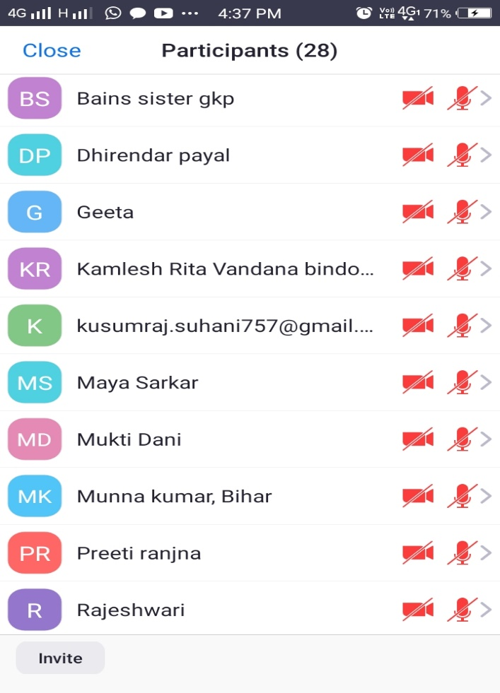
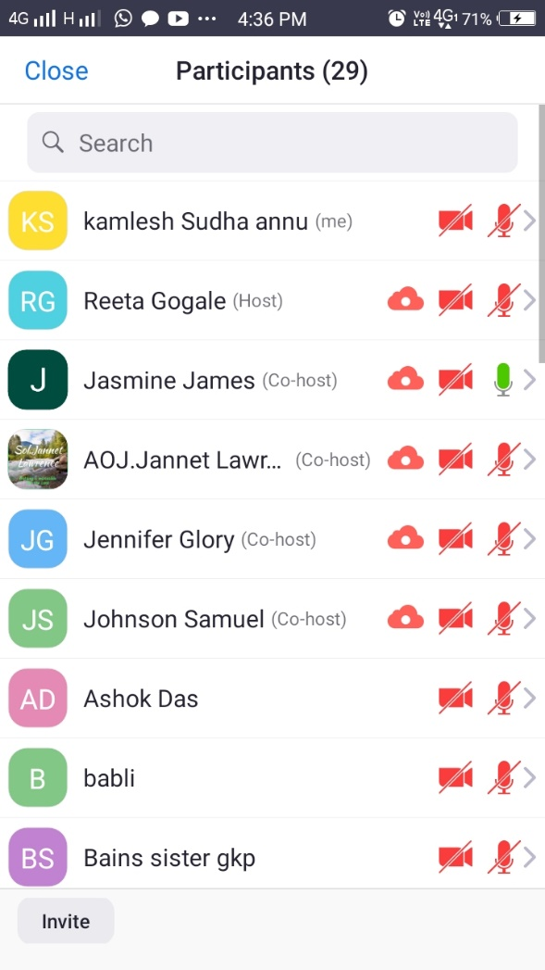
Participants
9. Number of troop churches formed
Job
Ezra
Markus
Esther
Joseph

Slide 4
WESTERN REGION- MAHARASTRA
Training Coordinator Name: Sol. KAVITA INGLE
Date:18/7/2021 to 21/7/2021
Time: 7.00 to 9:30 P . M
State: Maharashtra
Number of Participants: 24
6. Special thanks
First of all we are very thankful to God because he is with us and protect, encourages, giving all teachers strength and good connectivity, guide us in every situation
Also thankful of all MH AOJ team members
7. Testimonies
One of the sister understands that why failure our family face so during Failure family class she came to know why her family fails every time and she overcome this problem by the grace of god Amen.
During symbiotic disorder class one of the sister knew how failure come and how to fight with it by the word of god amen.
During this gift school many students were join they spoke that all the classes were good we understand each and every word of god we will improve our family communication and also they ready to give message and classes during gift school Praise god.

Slide 5
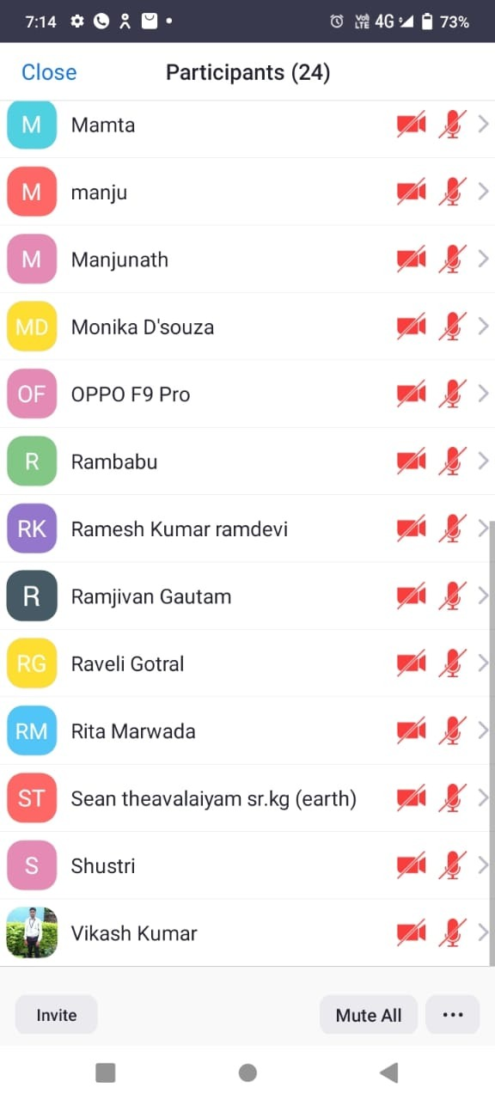
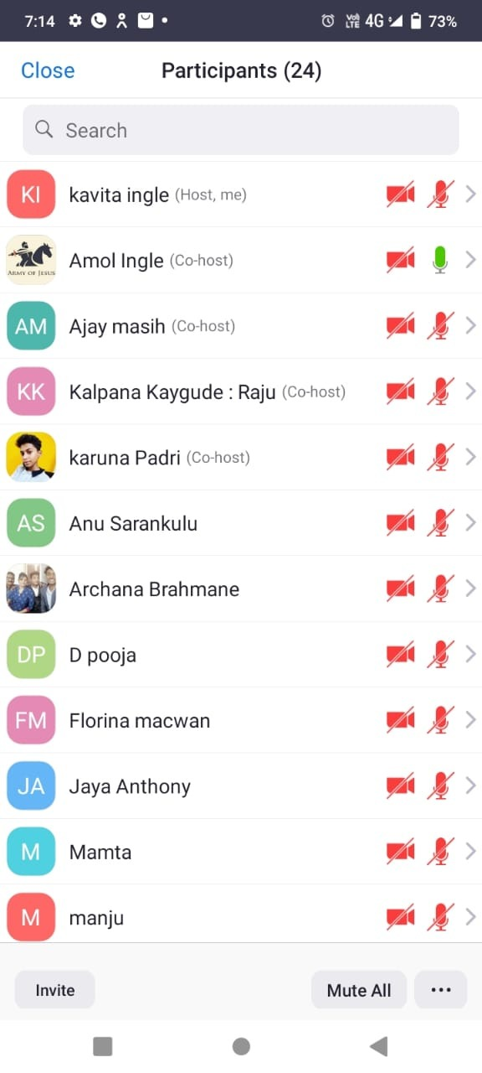
Teachers:
  Sol. Shakespeare
  Sol. Johnson
  Sol. ArunSol.
  Grishma
  Sol. Jasmine
  Sol. Jennifer
7. Teachers Raised:
  Sol.Archana Brahmane - 73877849672
  Sol.Brijesh - 99537788683
  Sol.Florina -96628001724
  Sol.Mamata - 73852661355
  Sol.Rita Marwada - 9106262601

Slide 6
CENTRAL REGION- MADHYA PRADESH
Training Coordinator Name: Sol. MONCY CHACKO
Date:23/7/2021 to 30/7/2021
Time: 9.00 to 10:30 P . M
State: Madhy Pradesh
Number of Participants: 25
  Teachers
  Sol. Shakespeare
  Sol. Johnson
  Sol. Arun
  Sol. Grishma
  Sol. Jasmine
  Sol. Jennifer

Slide 7
INTERNATIONAL – FIJI ISLANDS
Training Coordinator Name: Sol. Jennifer
Adopted State: Chandigarh
Date: 19/6/2021 to 25/7/2021
Time: 12.00 to 02:00 P . M
State: Fiji Islands
Number of Participants: 11 Nos
2. Testimonies
  Sister Shashi thanked and praised God for healing her. She had been taking injections for depression for some time. During the time she attended classes she was feeling much better and now the injection is replaced by tablet. Praise God.
  Sis. Rima gave thanks to God for touching her husband who is an unbeliever. He had never taken interest in any kind of prayers but these days he's been requesting for prayer. Praise God.
  Sol. Prem thanked God for the classes and he was grateful to God for blessing him with the knowledge of the word of God.
  Sol. Kusum praised God for the good things she came to hear from word of God and the prayers for her and her family.
3. Feed Backs
Sol. Prem thanked God for the classes and he was grateful to God for blessing him with the knowledge of the word of God.
Sol. Kusum praised God for the good things she came to hear from word of God and the prayers for her and her family.
All glory to God for their faith in Christ.

Slide 8
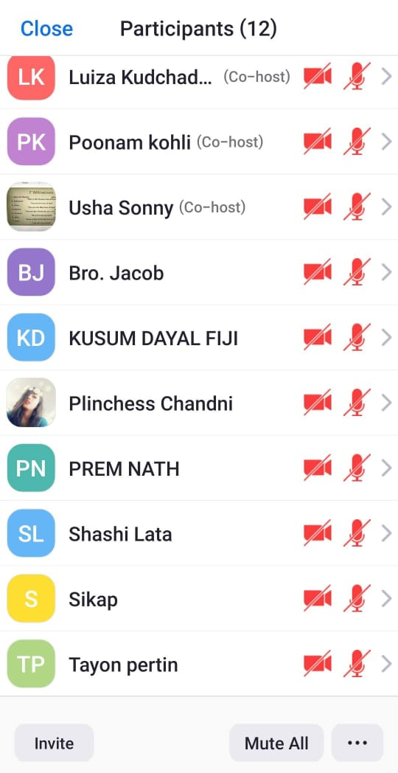
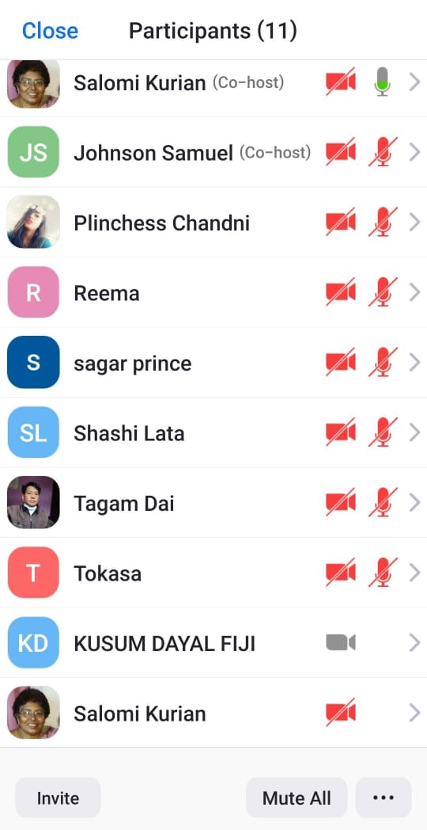
4. PARTICIPANTS

Slide 9
NORTH REGION - CHANDIGARH
Training Coordinator Name: Sol. Johnson Samuel
Date: 01/06/2021 to 09/06/2021
Time: 07.00 to 08:45 P . M
State: Chandigarh
Number of Participants: 56 Nos
6. Testimonies
Sol. Priyanka, who is a brahmin from Gurugram, testified that she was blessed by this class. She had been going through some problems with her husband. While she was attending the classes, she saw a change in her husband and she also learnt many things through the word of God which she didn’t know before. Through the classes she was able to change her attitude towards her husband. Praise God.
Sol.Babita from Uttrakhand was going through domestic violence. During the class she was able to understand and forgive her husband and break the curses. Glory to God.
Sol. Chandni, a hindu , is an international participant who joined from Fiji. She had some personal problems in her life. After learning about the word of god she got inner strength and peace. Now she prays every morning and night to Jesus. She also shared to her mum about Jesus. Glory to God.
7. Feed Backs
  Many families are blessed by attending Troop Church and Gift Schools.
  They see the spirit of the Lord working in their lives through healing, deliverance from evil spirits.
  Some families are living in a peaceful environment where there used to be fights and arguments before.
  Many of the new believers are joining troop church in the hope and believe that God will heal them.
  The new believers are telling others about the miracles and power of intercessory prayer in the troop church
8. Counselling
  Sol. Priyanka Eklavya : 9873532727

Slide 10
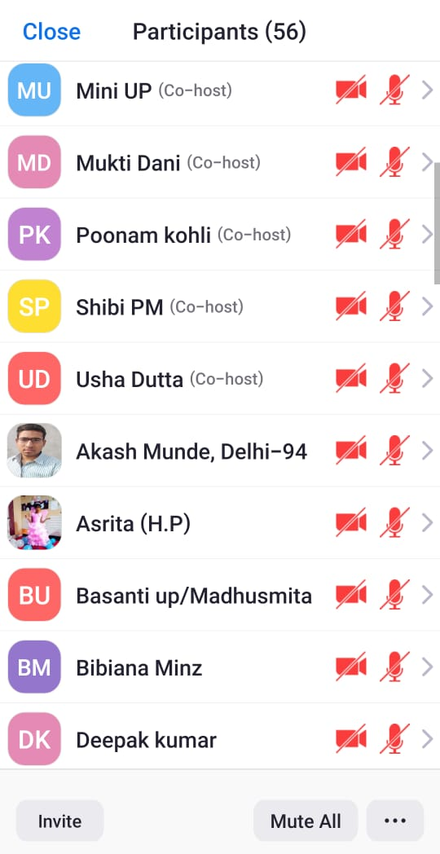
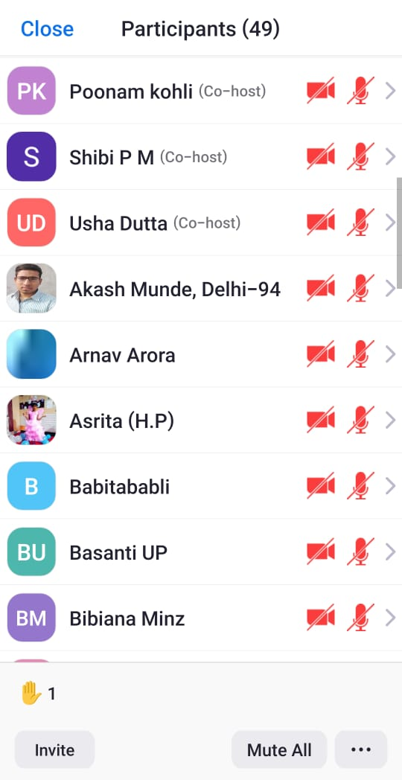
9. Teachers Interested for Training
  Sol. Kamlesh Kalra : 9899448208
  Poonam Kohli : 9560691709
  Menka : 7065718761
10. PARTICIPANTS

Slide 11
EAST REGION - ODISHA
Training Coordinator Name: Sol. Urimani
Date: 09/08/2021 to 12/08/2021
Time: 05.00 to 07:00 P . M
State: Odisha
Number of Participants: 15 Nos
Testimonies: Nil

